Slide 1

Create Your Calm

Slide 2


Anxiety is an Epidemic
40M+
Americans have an
anxiety disorder
43%
of adults feel more
anxious than last year
NIMH / ADAA
APA Annual Poll, 2024
1 in 3
adults will experience
anxiety in their lifetime
60%+
of Gen Z report an
anxiety disorder
NIMH, NCS-R Study
The Hill, 2023
200% increase in anxiety since 2008 (NIH/PMC, 2020)
People shut down. Relationships degrade. This generation is the most anxious in history.

Slide 3





The Cost of Anxiety at Work
$282B
annual cost of mental illness
in the U.S. — 1.7% of GDP
Columbia / Yale, 2024
12 Bn
working days lost globally to
anxiety & depression each year
WHO
63%
of employees report burnout
& are 63% more likely to call in sick
Gallup, 2022
Every $1 invested in mental health returns $4 in productivity. Employers are spending — EchoScape can capture this. (WHO / Harvard Business School)

Slide 4





Meditation Works
Clinically proven to reshape the brain, lower stress hormones, and improve outcomes.
23%
16%
40%
cortisol reduction
attention span increase
better therapy outcomes
Reshapes the brain
in just 8 weeks
Sustained focus improvement
after 8-week program
When meditation is combined
with traditional treatment
Harvard Medical School
JAMA, 2020
APA, 2022
Non-invasive. Zero side effects. The science is clear: meditation should be the first line of defense.

Slide 5
But Only 20% Meditate Regularly
95%
of meditation app
users quit within
30 days
Customer Insights Research
"My mind wanders too much"
62%
Psychology Today / Carnegie Mellon, 2025
"Not enough time"
56%
3.3%
median Day 30
retention for mental
health apps
"I need to move"
46%
"It feels like a chore"
41%
Baumel et al., JMIR, 2019
The core issue is consistency. The biggest predictor? How calm people feel during the experience. If it feels frustrating, they quit. If it feels calming, they come back.

Slide 6
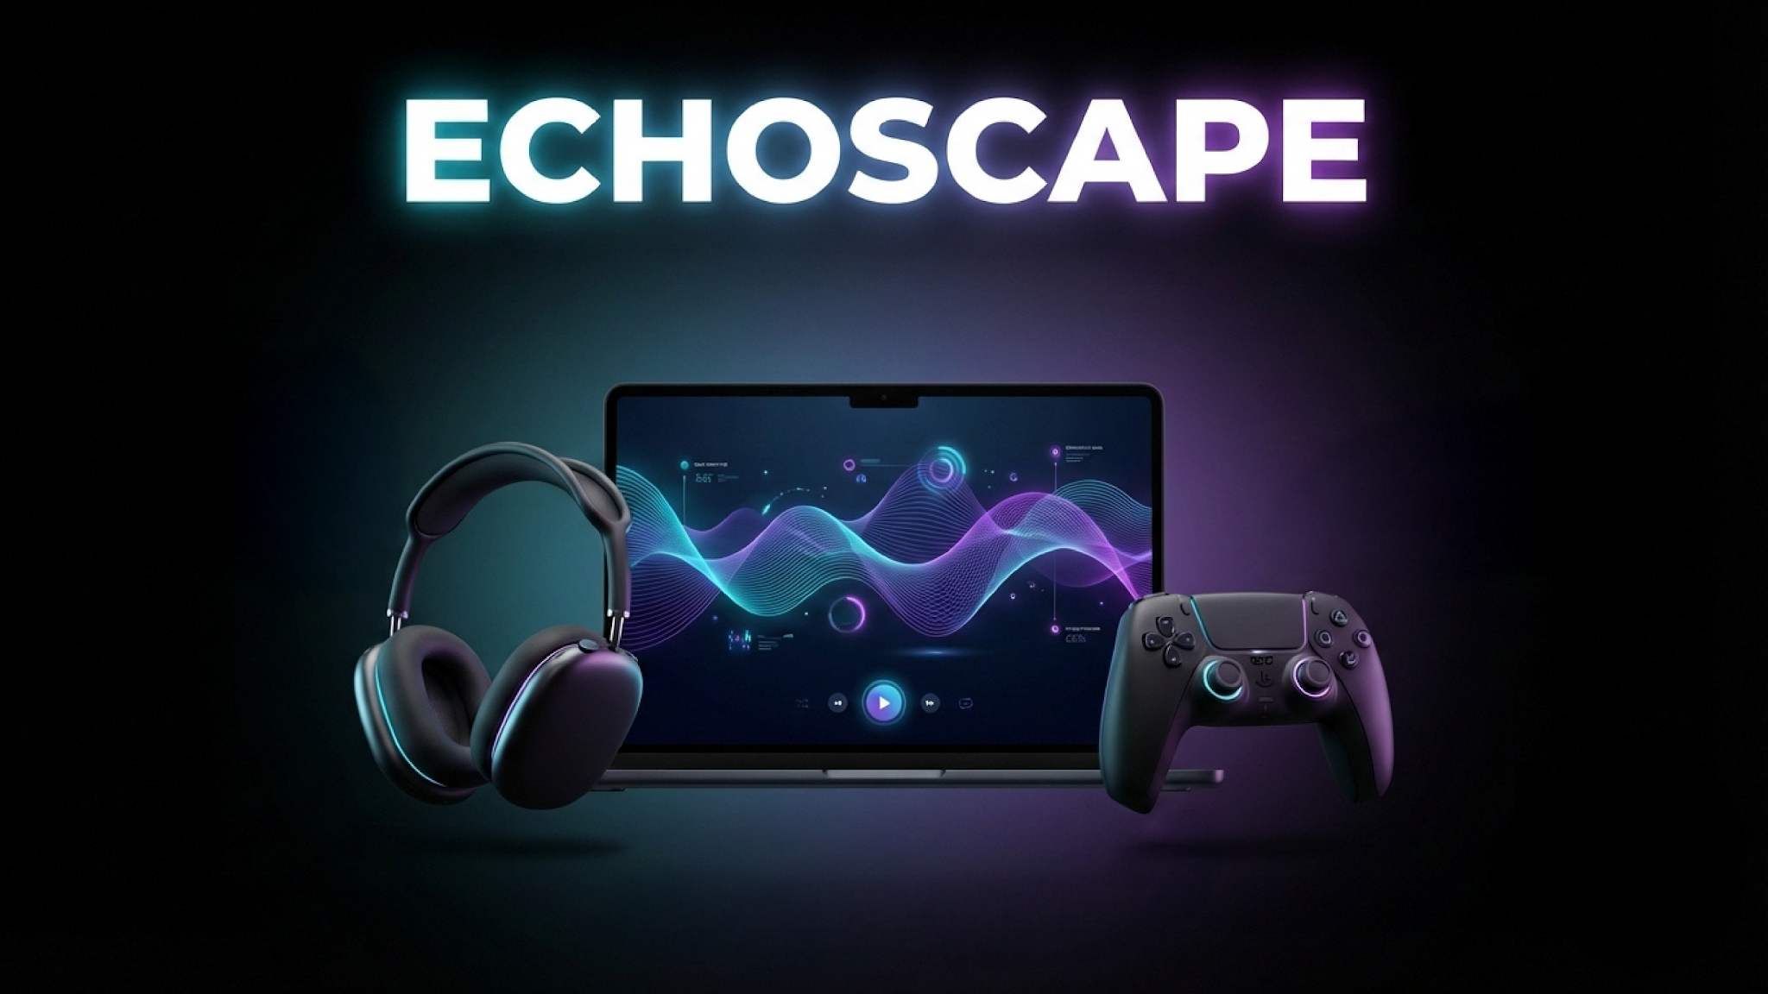

Slide 7





Sound Healing is Neuroscience
Sound
Immersion
Body
Responds
Calmness
Increases
Consistency
Follows
Activates parasympathetic
nervous system
Lowers cortisol, regulates
heart rate variability
65% improvement
in reported calmness
Calm experience = people
come back again
Sound immersion activates the parasympathetic response
Music & Medicine Journal, 2019
Swelling soundscapes regulate heart rate variability
Journal of Music Therapy, 2020
Vibroacoustic stimulation induces deeper relaxation than meditation alone
Frontiers in Network Physiology, 2026
With EchoScape, sound doesn't just play — it responds to you. Interactive sound is the key to sustained calm.

Slide 8





Game Controller Drives Calmness
Movement meditation = sitting meditation
RCT with 161 participants found no difference in effectiveness
Mindfulness Journal, 2023
Fidget devices reduce anxiety & stress
Physical input boosts dopamine in the same pathways as ADHD meds
ScienceDirect, 2025 / Harvard Medical School
Stillness can actually worsen ADHD symptoms
Traditional meditation draws attention to inattention, undermining benefits
Frontiers in Psychology, 2021 (Murrell et al.)
Instead of fighting a wandering mind, EchoScape guides it. The controller gives anxious brains exactly what they need: something gentle to focus on.

Slide 9
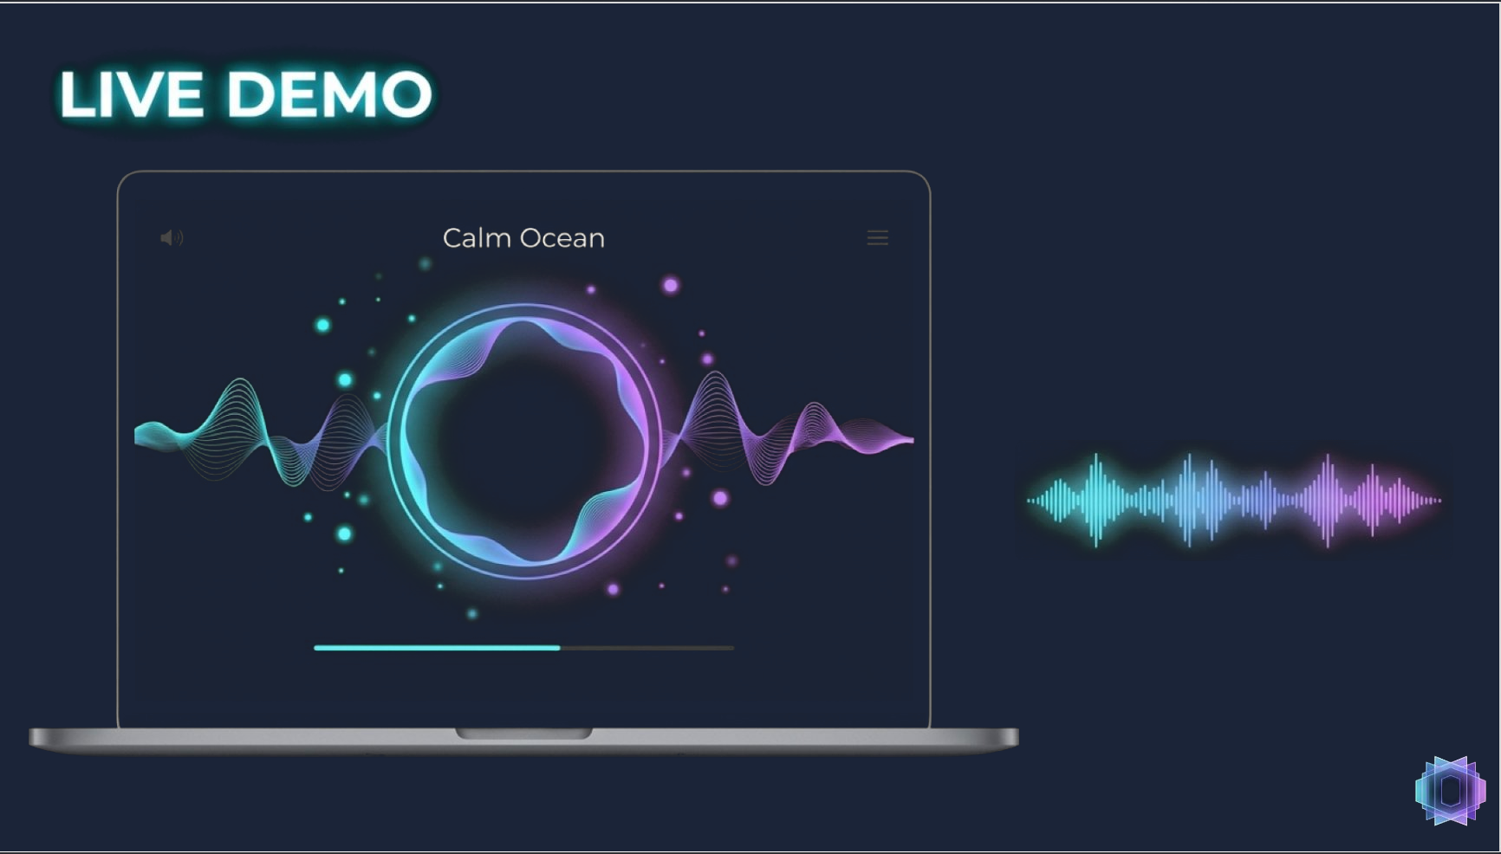

Slide 10


97%
of EchoScape users felt more calm
40 Participants | Ages 18-35 | 2 Week Beta
Restlessness Score
Focus
8.2 3.1
~5 min
Maintained
before after
average session length
Time is not a barrier
Most participants reported
their mind stayed focused
"Calming yet stimulating!"
"It didn't feel like meditation.
It felt like a game I wanted to play."
"My anxiety dropped
from an 8 to a 3."
Next step: formal neuroscience study with Mount Sinai researchers to clinically validate EchoScape's anxiety reduction.

Slide 11
Only EchoScape Lets You Create Your Calm
EchoScape
Calm
Playne
Tripp
Interactive
motion + sound
Passive
meditation app
Passive meditation
video game
VR soundscape
experience
Interactive Sound Engine
✔
✘
✘
✘
Controller / Motion Input
✔
✘
✔
✔
Multi-sensory (Audio + Haptic)
✔
✘
✘
✔
Personalized Journey
✔
✔
✔
✘
User Creates the Experience
✔
✘
✘
✘
No competitor combines meditative motion with interactive sound. EchoScape occupies a category of one.

Slide 12
67M Anxious Gamers. We Built This for Them.
TAM
Total Addressable Market
$4.2B
U.S. meditation & mindfulness app market
Statista / Grand View Research, 2024
SAM
Serviceable Available Market
$850M
Gaming + wellness intersection (82M gamers 18-35)
ESA, 2025 / ScienceDirect, 2024
SOM
Serviceable Obtainable Market
$45M
Gamers aged 18-35 with anxiety/ADHD (3-year target)
150K-500K users, $5M-$20M ARR
Phase 1 (Year 1)
Phase 2 (Year 2)
Phase 3 (Year 3)
Gamers with anxiety/ADHD
Lapsed meditators
Corporate wellness
Meditation built for the gaming generation. Market growing at 18.6% CAGR to $153B by 2034. (Towards Healthcare, 2024)

Slide 13



Revenue Model: 3 Revenue Streams
Steam Launch
Mobile Scale
B2B Wellness
147M active users
iOS + Android
Corporate programs
$15-20
$4.99/mo
$5-15
base game
or $29.99/year
per employee/month
+$5 quarterly expansions
Free tier: 3 environments
Calm charges $5-15/seat
PC and Mac
Premium: unlimited access
ADHD-specific positioning
Built-in discovery
10% free-to-paid conversion
4,000+ companies in market
Month 3
$5K MRR
1,000 users
Month 12
$50K MRR
10,000 users
Year 3
$5M+ ARR
50K-150K users
LTV: $180 CAC: $6 LTV:CAC = 30:1 | Built-in user base of 147M Steam gamers means low acquisition cost
Calm: $596M revenue (2024) | Headspace: $348M revenue (2024) | EchoScape enters with zero direct competitors

Slide 14
Roadmap to $5M+ ARR
Month 1-3
Month 4-6
Year 1
Year 2-3
Build
Launch
Grow
Scale
Hire engineering team
Full production development
Sound library creation
Steam Early Access
User feedback + iteration
First 1,000 users
Full Steam release
Content updates + analytics
Scale to 10K users
iOS + Android launch
Corporate wellness pilots
B2B enterprise contracts
$5K MRR
$50K MRR
$5M+ ARR
Phase 1
Gamers with anxiety/ADHD
Phase 2
Lapsed meditators
Phase 3
Corporate wellness
Core beachhead market
300M+ app downloads, 95% quit
$20-24B market, 91% investing more
Each phase expands the addressable audience while building on proven traction. Year 1 validates. Year 2 scales. Year 3 compounds.
150K-500K users | $5M-$20M ARR | Series A ready by end of Year 1

Slide 15
ECHOSCAPE Team
Photo
Photo
Mike Ahearn Wilcox
Greg Donovan
Natalia Pollack
Founder
Advisor
Programmer
Small team. Big vision. Ready to scale with the right investment.

Slide 16




The Ask: $250,000 for Full Development
$250K
What This Delivers
Month 3
1,000 users
Steam Early Access live
2 Engineers + 1 Designer
$150K
60%
Month 6
5,000 users
Full Steam launch
Sound Library Expansion
$40K
16%
Month 12
10,000 users
Mobile expansion begins
Marketing + Press Outreach
$40K
16%
Year 2
50,000 users
Infrastructure + Scaling
$20K
8%
B2B wellness pilots
$250K gets EchoScape to market, to users, and to Series A readiness within 12 months.

Slide 17

QR Code
SCAN TO JOIN
OUR JOURNEY
Thank you. Let's create calm together.
mike@echoscape.app | echoscape.app

Slide 18
Appendix

